Slide 1
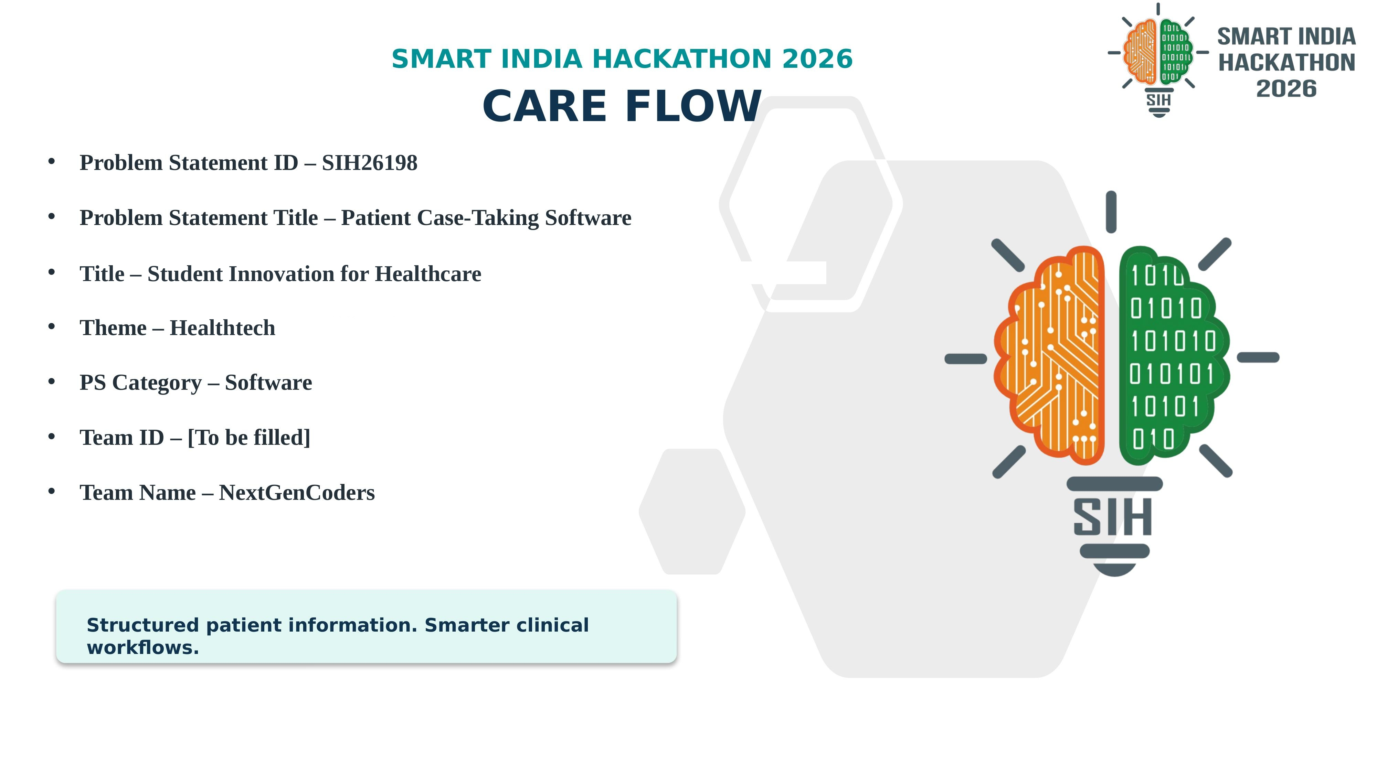

Slide 2


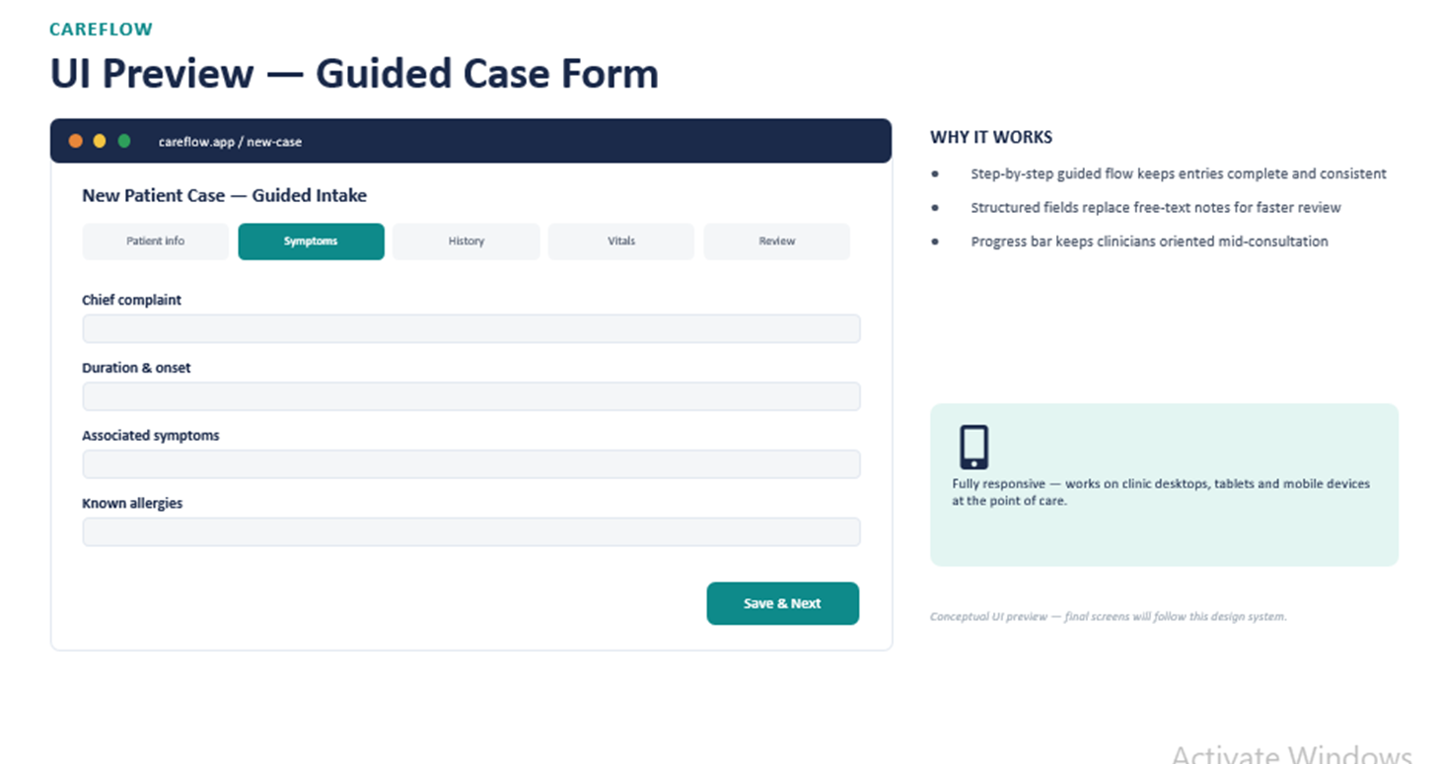
NextGenCoder
CAREFLOW
Problem & Solution
THE PROBLEM TODAY
OUR SOLUTION — CAREFLOW
Patient case notes scattered across paper sheets and disconnected records
Repetitive manual questioning at every visit wastes clinician time
Incomplete, illegible histories slow down retrieval during consultation
No structured way to search, audit or reuse past case data
Capture — guided forms for symptoms, history, vitals, allergies & complaints
Organize — scattered notes become one structured, searchable case record
Access — role-based access lets authorized staff view and update safely
TRADITIONAL PROCESS vs. WITH CAREFLOW
 | Traditional | With CareFlow
Documentation | Manual, repetitive, paper-based | Guided, one-time structured entry
Retrieval | Slow, manual search through files | Instant, searchable digital record
Access control | Uncontrolled, no audit trail | Role-based, audit-friendly logs
CareFlow | Smart India Hackathon 2026
2

Slide 3
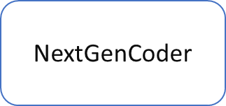










CAREFLOW
Technical Approach
IMPLEMENTATION WORKFLOW
PROPOSED TECHNOLOGY STACK
1
2
3
4
5
FRONTEND
React — responsive web UI
Patient
intake
Guided case
form
Validation
& save
Clinician
review
Update /
export
BACKEND
Node.js — REST APIs
HOW IT WORKS UNDER THE HOOD
React front-end renders condition-aware guided forms; each step posts to REST APIs on the Node.js layer.
Node.js validates payloads, applies RBAC checks, then writes structured records to PostgreSQL.
Every read/write is logged for audit; clinicians pull records instantly through the same API layer.
DATABASE
PostgreSQL — structured records
Architecture principle: modular forms + API layer + secure structured storage, built for incremental deployment and future interoperability.
SECURITY
Auth, RBAC, audit logs
GITHUB REPOSITORY
pahttps://github.com/shivraghuwanshi777-uiste your repo link here
CareFlow | Smart India Hackathon 2026
3

Slide 4





CAREFLOW
Feasibility & Viability
TECHNICAL FEASIBILITY
OPERATIONAL FEASIBILITY
ECONOMIC FEASIBILITY
Widely-adopted web stack. Modular design. Browser-based MVP — no special hardware.
Guided workflows cut training time. Forms adapt to each department’s process.
Software-first build enables phased rollout, reuse of existing devices, controlled cost.
RISKS → MITIGATION
Data privacy & unauthorized access
RBAC, encryption, secure sessions, audit logs
Inconsistent or incomplete entries
Required fields, validation, configurable templates
Adoption resistance / workflow mismatch
Pilot testing, user feedback, phased deployment
CareFlow | Smart India Hackathon 2026
4

Slide 5




CAREFLOW
Impact & Benefits
CareFlow improves the quality and continuity of information at the first point of clinical interaction.
FOR PATIENTS
FOR CLINICIANS
FOR FACILITIES
Less repetitive questioning, smoother intake
Quick access to structured history, less time searching
Standardized records, traceability, analytics-ready
PROJECTED IMPACT — BEFORE vs. AFTER CAREFLOW
FUTURE SCOPE
Multilingual & voice-assisted entry
FHIR-based interoperability
Dashboards & hospital-system integration
*Projected / illustrative estimates based on workflow analysis, to be validated during pilot testing.
CareFlow | Smart India Hackathon 2026
5

Slide 6




CAREFLOW
Research & References
Reference areas informing the proposed design
DIGITAL HEALTH WORKFLOW CONTEXT
HEALTH DATA INTEROPERABILITY
World Health Organization — Global strategy on digital health 2020-2025
HL7 FHIR — standards context for future structured data exchange
who.int/publications/i/item/9789240020924
hl7.org/fhir
APPLICATION SECURITY
PROJECT VALIDATION
OWASP — secure design & web application security guidance
User interviews, workflow observation, prototype testing & institutional feedback
owasp.org/www-project-top-ten
To be filled
Note: Product-specific clinical validation, institutional approvals and deployment references will be added during prototype development.
CareFlow | Smart India Hackathon 2026
6

